Slide 1
DEPARTMENT OF CHEMICAL ENGINEERING
ENGINEERING IN SOCIETY (CENG 291)
PRESENTATION BY
MASTER KPORXAH FREEMAN GENIUS
ON THE TOPIC:
PRESERVATION OF RED PALM FRUITS IN MY COMMUNITY.

Slide 2
OUTLINE
INTRODUCTION
AIMS AND OBJECTIVES
SUGGESTED SOLUTIONS
CONCLUSIONS
RECOMMENDATIONS

Slide 3
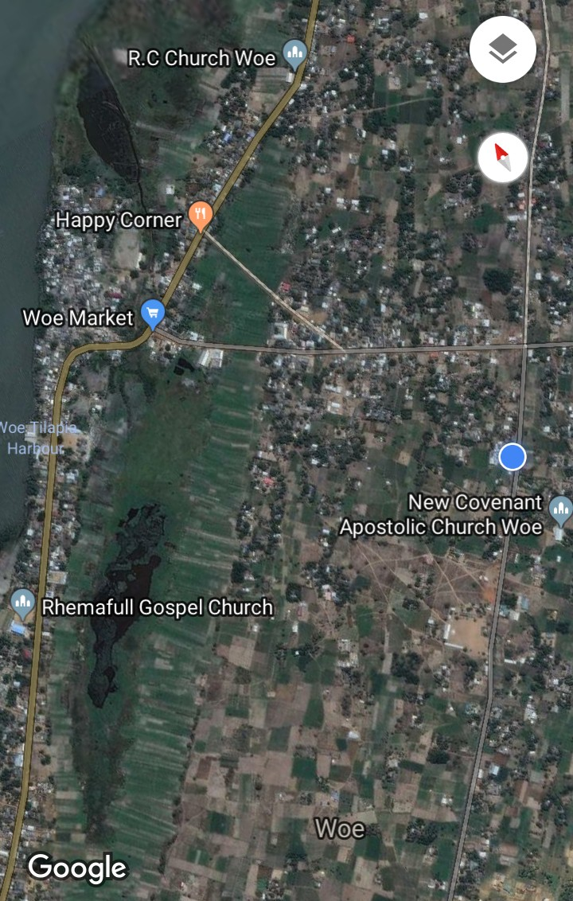
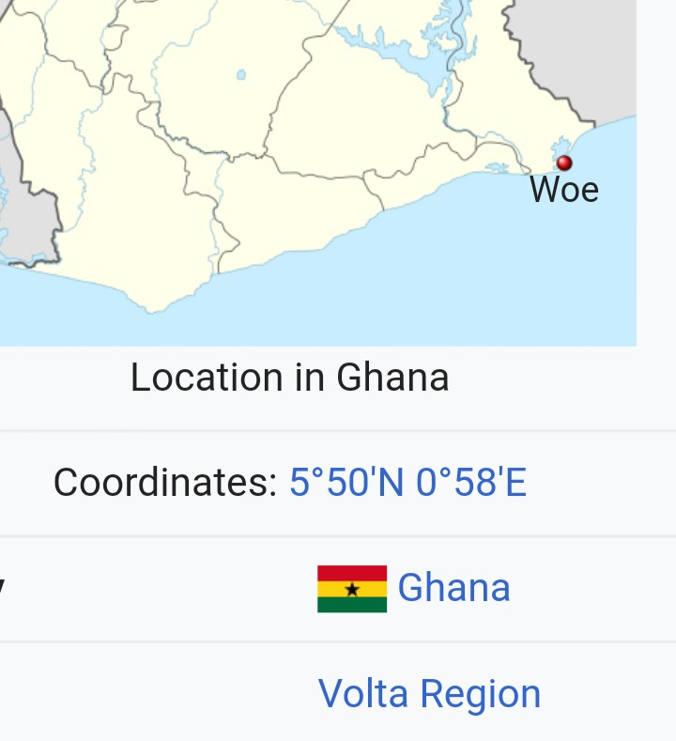
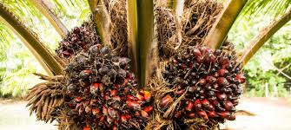
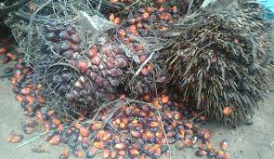
INTRODUCTION
Red palm fruits has many uses such as palm oil and kernel oil
Get nutritive vitamins and antioxidants
Income to farmers and revenue to the state
The location of this problem in Ghana

Slide 4
Aims and objectives
To preserve red palm fruits in Woe community.
To sensitize the farmers on other relevance of red palm fruits.

Slide 5
SUGGESTED SOLUTIONS TO ADDRESS THE PROBLEM
By applying radiation techniques: Radiations by gamma rays is one main ways to minimize to spoilage of palm fruits.
By applying some chemicals: some acids such as
sulphur dioxde and its derivatives can be considered as universal preservative.
Benzoic acid and its derivatives

Slide 6
RECOMMENDATIONS
I recommend that more investigations are carry out about these problems
By government agencies
Corporate organizations or
Well to do individuals in the my community

Slide 7


SUGGESTIONS &

